Slide 1
Hash functions

Slide 2
Hash functions
A hash function is any function that can be used to map data of arbitrary size to fixed-size values.
The values returned by a hash function are called hash values, hash codes, or simply hashes.
Hashes are in general case irreversible, i.e. in general case you cannot get the origin data from the calculated hash.

Slide 3
Hash functions Collisions
A collision is a situation that occurs when two distinct pieces of data have the same hash value.
Collisions are unavoidable whenever members of a very large set are mapped to a relatively short bit string.

Slide 4
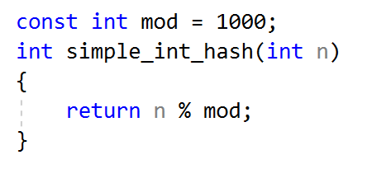
Hash functions Examples
Let’s define some hash functions for example.
Simple hash function:

Slide 5
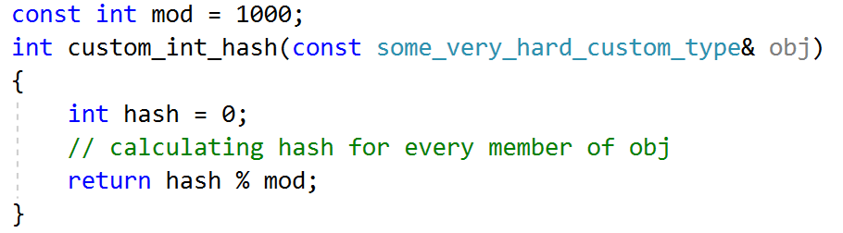
Hash functions Examples
Let’s define some hash functions for example.
Custom class hash function:

